Slide 1

Summer Undergraduate Research Award 2024
Prediction of viscosity of Non-Newtonian fluids at different shear rates and temperatures using artificial neural network models
Applicant: Lakshya Kumar (2022TT12183)
Abhiraj Kumar Koslia (2022TT12187)
Department: Dept. of Textile & Fibre Engg.
Facilitator: Prof. Abhijit Majumdar
Department: Dept. of Textile & Fibre Engg.
Notes:
Hello Everyone! A very good evening to one and all present here. Before starting with our presentation, I would like to give a brief introduction about the team for this project. I am Abhiraj, this is Lakshya. Both of us are pursuing our bachelors in the textile department AND CURRENTLY WE ARE DR 4 AND 2 RESPECTIVELY. Together, we will be pursuing this project under the guidance of Prof. Abhijit Majumdar.

Slide 2
Table of Contents
1
Introduction
2
Objectives
3
Methodology
4
Future Scope
5
Timeline
6
Budget
7
Conclusion
Notes:
This presentation would be covering the introduction, objectives and methodology we will be undertaking, followed by the Future scope, timeline, budget and finally conclusion.

Slide 3
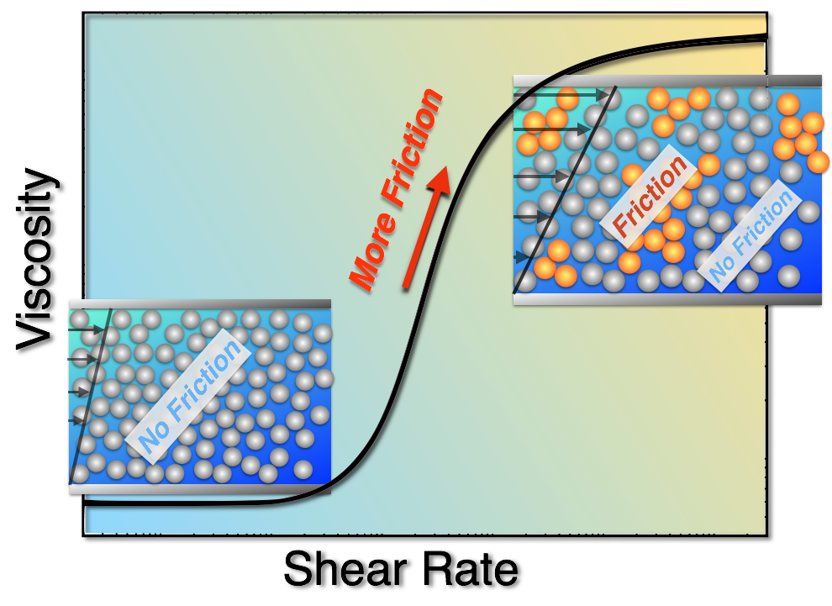
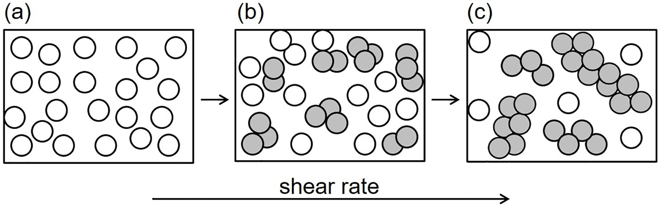
01.
Introduction
Shear thickening fluids (STFs) are a unique class of non-Newtonian fluids that exhibit an extraordinary transition from liquid-like to solid-like behavior when subjected to high shear rates or impact forces.
Notes:
This remarkable property arises from the formation of hydro clusters or jamming clusters of particles suspended in the fluid, which resist flow under high shear. STFs have garnered significant interest due to their potential applications in developing impact-resistant materials, such as body armor, protective gear, and energy-dissipating systems.
In simple terms, when STF encounters a high speed impact, the apparent change in its viscosity is so high that it behaves like a solid, and this transition is reversibe upon removal of impact.

Slide 4
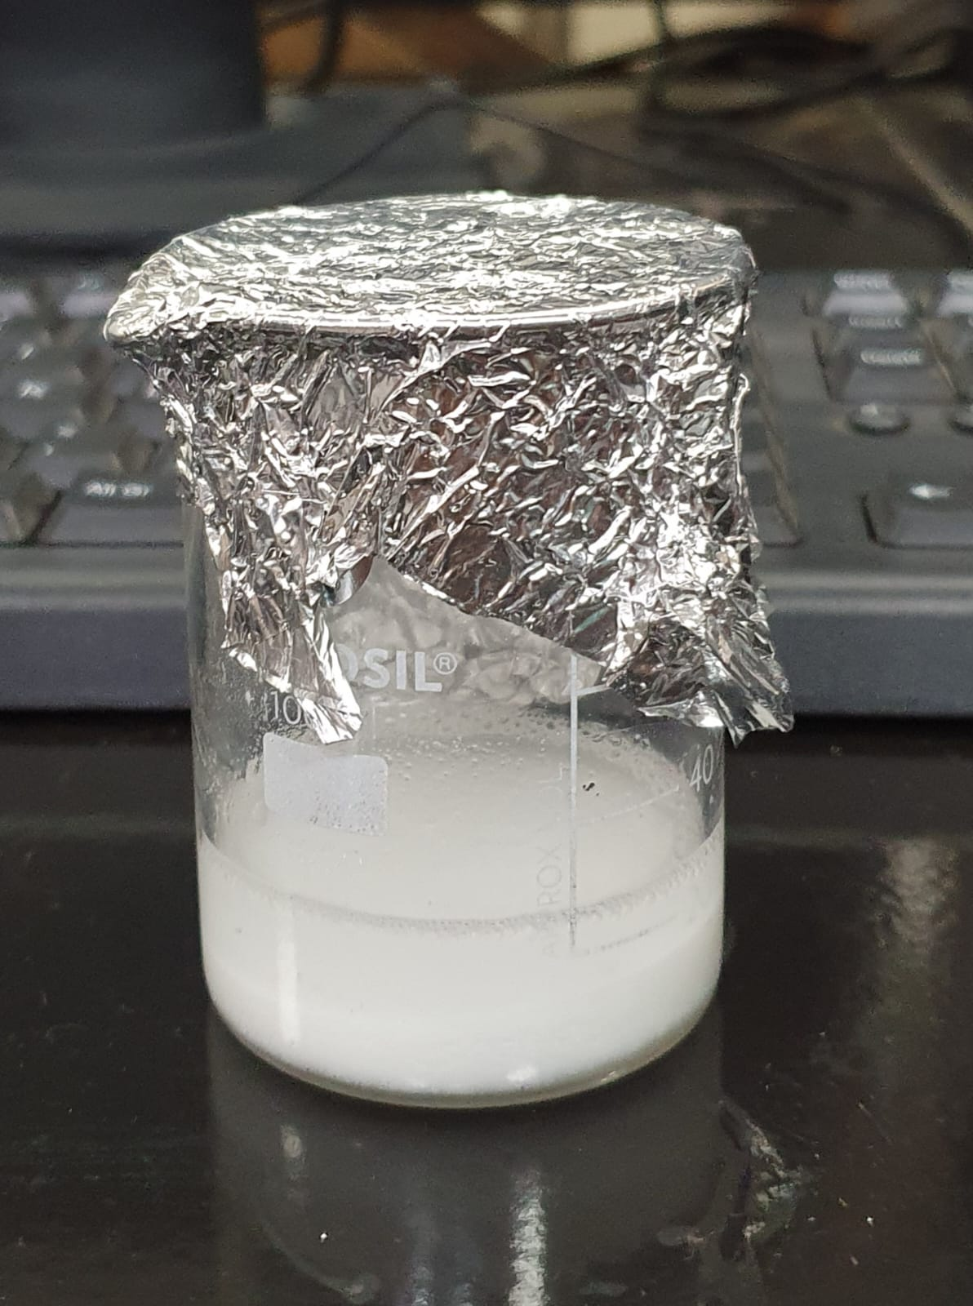
02.
Objectives
The main objective of our project is to analyze the changes in viscosity of a non-Newtonian fluid due to changing parameters such as particle size and temperature.
Sub-objectives
→ Synthesis of Shear Thickening Fluids (STFs)
Perform rheological studies on the prepared STFs
→ Building a predictive model using artificial neural networks.
→Optimization of ANN model to achieve best prediction accuracy.
(self generated)
Notes:
We will look into

Slide 5
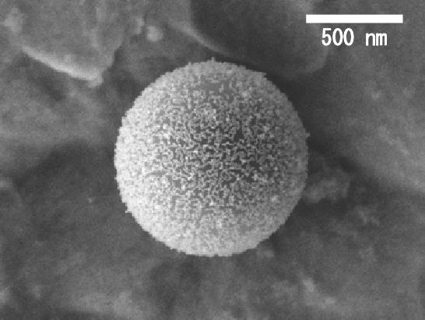
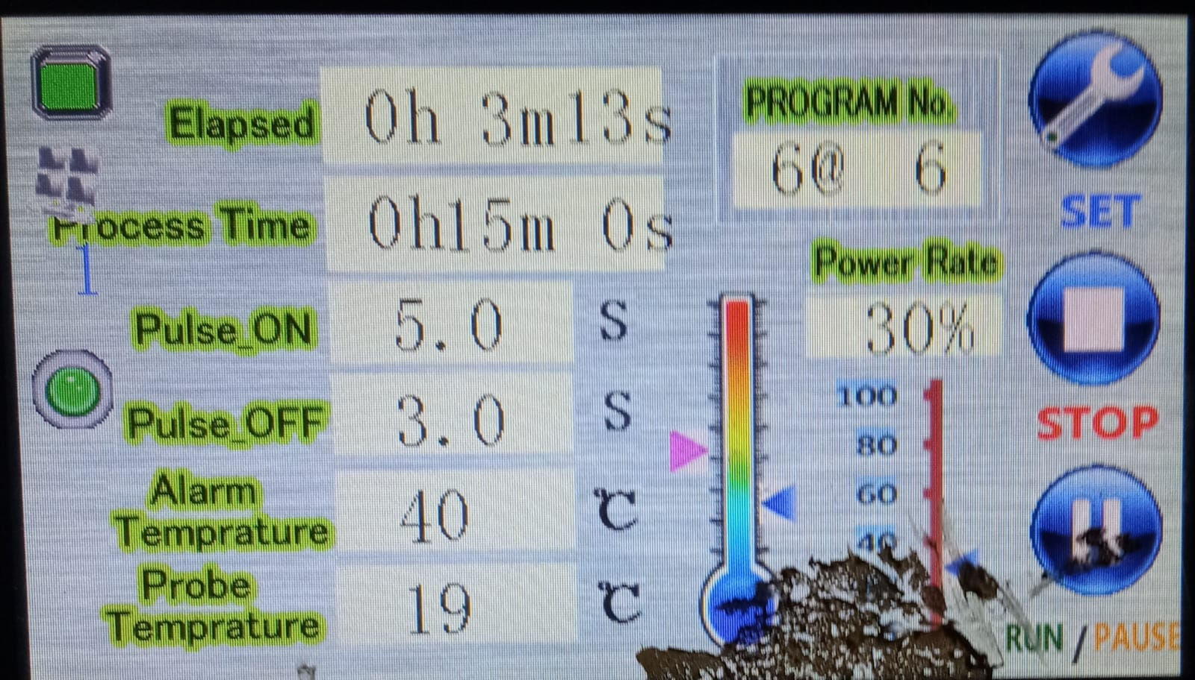
03.
Methodology

Slide 6

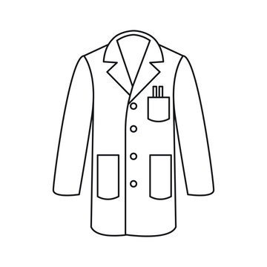
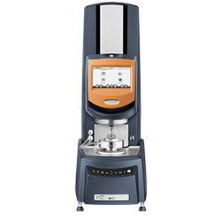


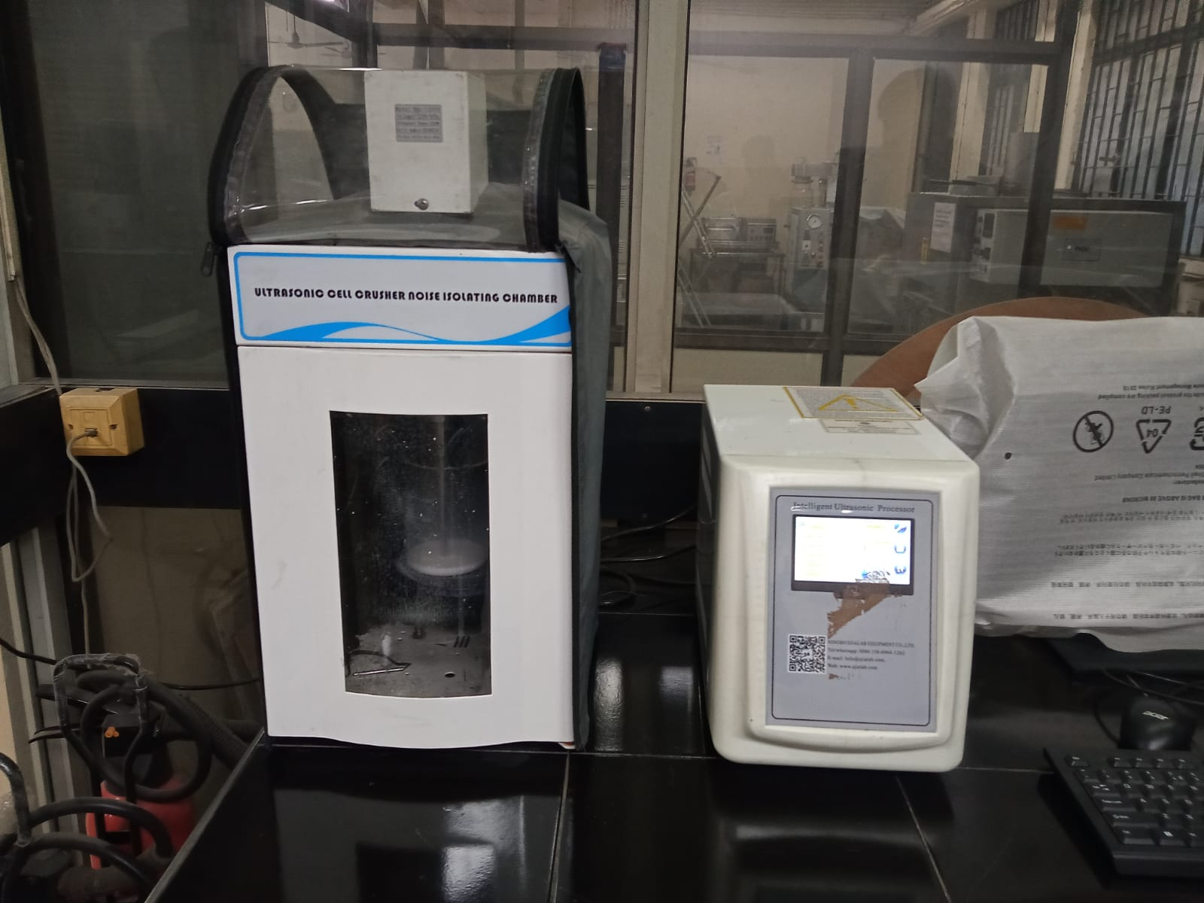
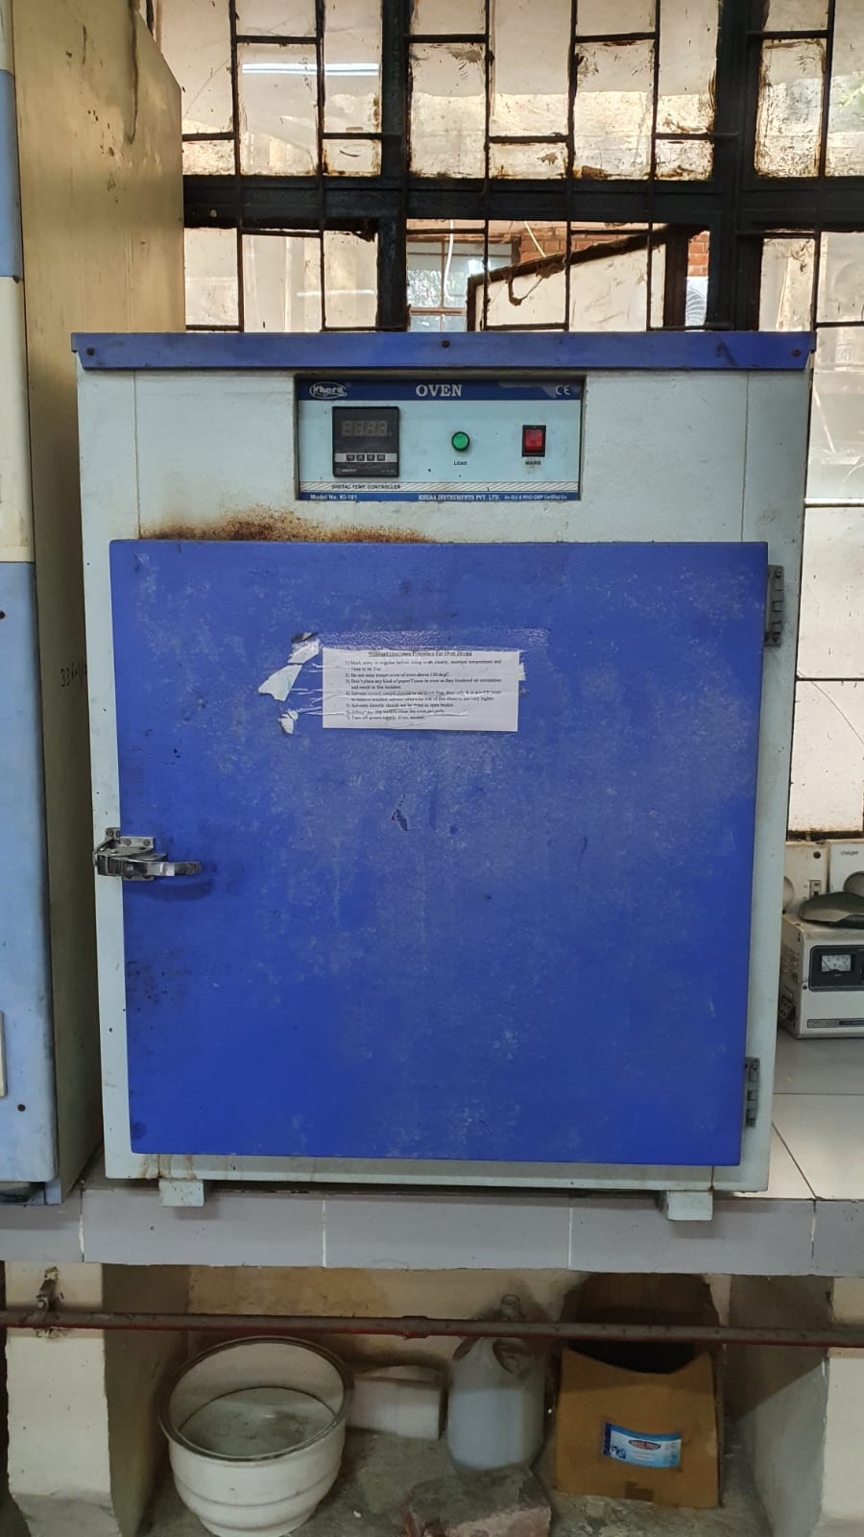


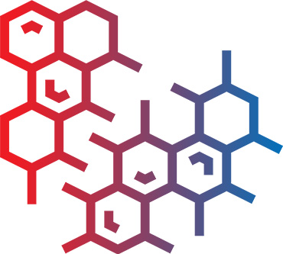
Experimental aspect:
3.1 Experimental Design
Particle sizes
Temperatures
Equipments Needed
100 nm
500 nm
20˚C
40 ˚C
300 nm
30 ˚C
3.2 Sample Preparation
Weigh and Measure
Disperse in the PEG
Ultrasonicator to ensure proper mixing
Mixture allowed to rest in Oven
Notes:
The setup will consist of three types of silica nanoparticles, each of which will be tested at 3 different temperatures. Machines that we will need for the same are Rheometer,Ultrasonicator,Oven and lab equipments like Beaker,stirrer,weighing machine, gloves etc.
Firstly, The nanoparticles should be dried at temp. of about 120 degrees. Then for sample prep.,we have to prepare a sample mixture of 10 g, which consists of 6.5 g silica particles, 3.5 ml PEG and 14 ml of ethanol (in 4:1 ratio). This mixture will now be kept in ultrasonicator to prevent accumulation of nanoparticles and enhancing the dispersed state of the mixture. After thorough mixing, the mixture now must be kept in oven at 80 degrees till evaporation of ethanol is completed.

Slide 7
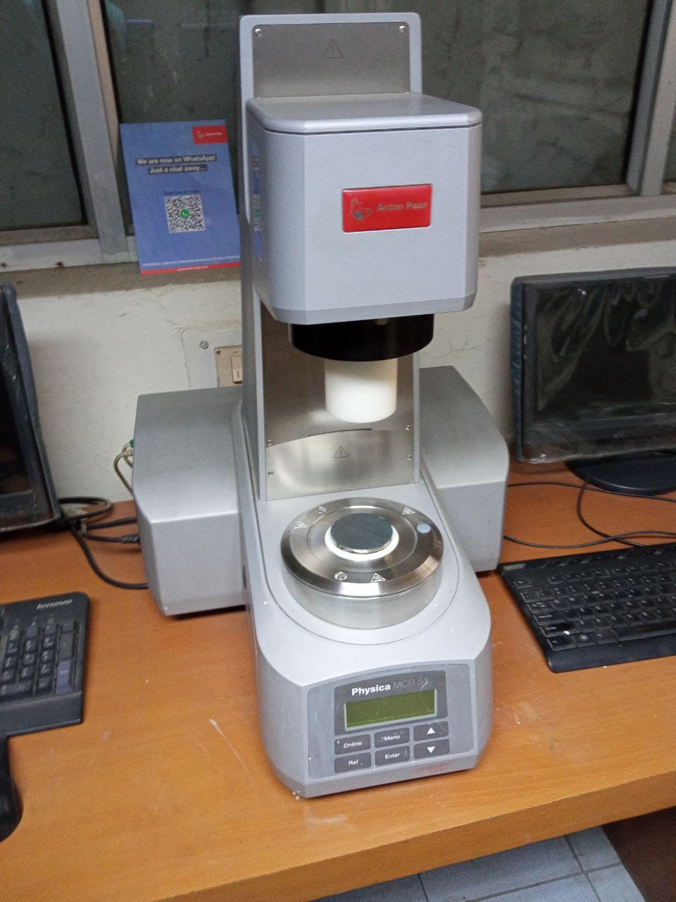
3.3 Rheology Testing
Using the prepared samples, we will conduct rheology testing on the rheometer.
Viscosity measurements will be taken at various shear rates (controlled by the rheometer settings) at the specified temperatures.
Data collected will include shear rate, temperature, speed and the corresponding viscosity values for each sample.
The viscosity data obtained from the rheology tests will serve as the training dataset for the artificial neural network models.
Each data point will consist of:
Input: Shear rate, temperature, nanoparticle size
Output: Viscosity

Slide 8
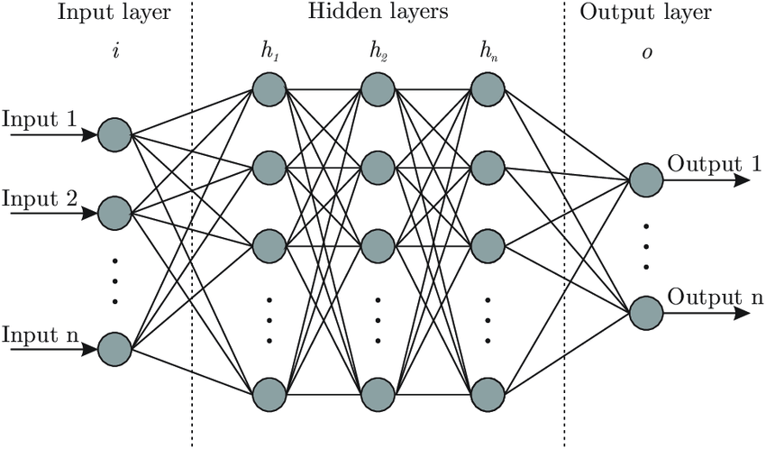

Computational aspect:
3.5 Artificial Neural Network (ANN) Model Development
We will design an ANN model using Python language, by making use of libraries like TensorFlow.
The input layer will have nodes for shear rate, temperature, and nanoparticle size.
The output layer will predict the viscosity.
Notes:
scikit-learn,pandas,numpy. We will build an model with 3 layers. input layer,output and one hidden layer. The input layer will have 3 neurons for shear rate,temperature, and nanoparticle size. And the output layer would be for viscosity. (3x3 weights,3biases ,3 weights and 1 bias) 16 parameters). The training algorithm currently we have decided upon will be back propagation or levenberg marquadt algorithm. Levenberg combines the steepest descent method for its stable performance along with gauss-newton algo for speed.
Learning rate is a tuning parameter in an optimization algorithm that determines the step size at each iteration. Momentum considers previous weight changes when updating current weights. Loss function-mae if outliers exist.

Slide 9
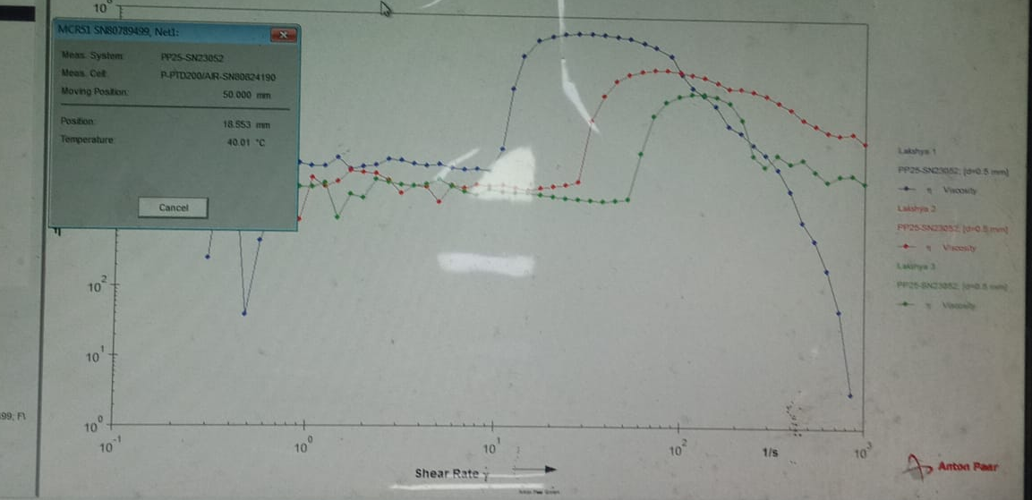

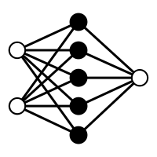
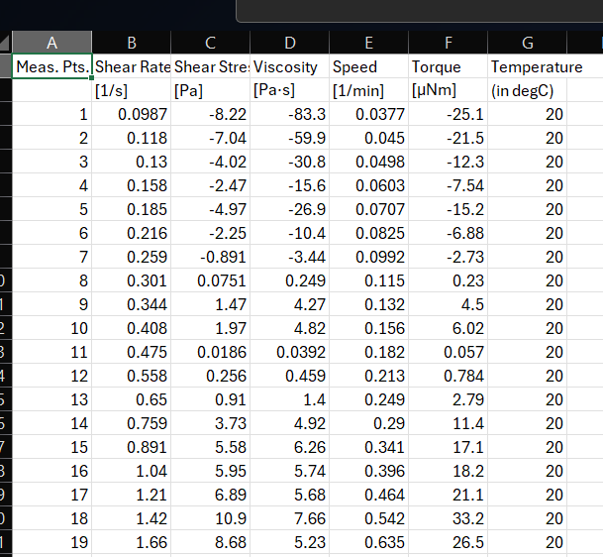


3.6 Prediction & Analysis of Viscosity
With a trained and validated ANN model, we will input new data (shear rate, temperature, nanoparticle size) to predict viscosity.
The model will output the estimated viscosity values for the given conditions.
MODEL
OPTIMIZATION OF CODE AND MINIMIZING ERRORS
TEST DATASET
Notes:
We will analyze the predicted viscosity values and compare them to actual measurements to validate the model's accuracy
Any discrepancies will be investigated to improve the model if necessary.

Slide 10
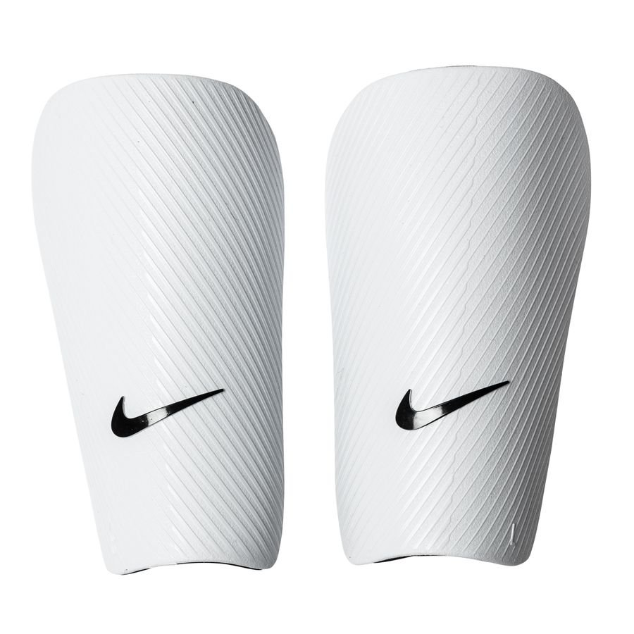
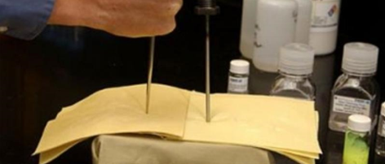
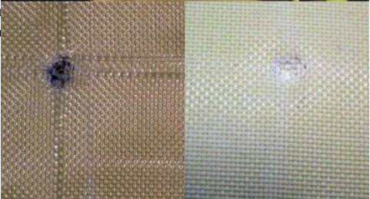
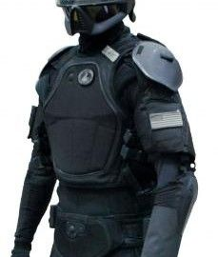
04.
Future Scope
Protective equipments: STFs can be integrated into fabrics for ballistic testing and understanding their applications like anti-stab armor and shin guards.
Motion sensors and lithium battery electrolytes: STFs have been explored as motion sensors due to their viscosity changes in response to applied forces, and as potential electrolytes in lithium-ion batteries to enhance safety and performance.
Shock absorbers: The energy dissipation capabilities of STFs make them suitable for use as buffer materials in vibration damping and impact absorption applications.

Slide 11
05.
Timeline
Experimental aspect
Sample Preparations
Rheology Testing
Data Gathering
1st Month
Literature review
Vary parameters
Record observations
Collect data
Computational aspect
Build Model
Train Model
Efficiency Testing
2nd Month
Literature review
Build primary model
Train on training set
Check efficiency using testing dataset
Notes:
The first month will go into literature review of experimental aspect of this project, alongwith sample preparations, rheology testing and data gathering for next month’s work. This month will cover literature review of the computational aspect of this project, building ANN model, training it and checking its efficiency.

Slide 12
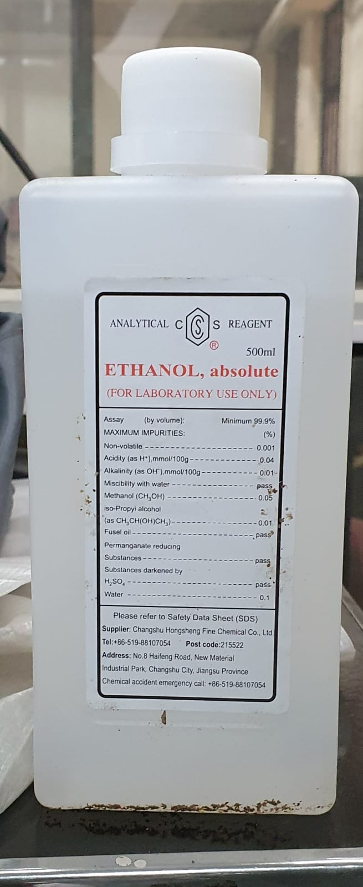
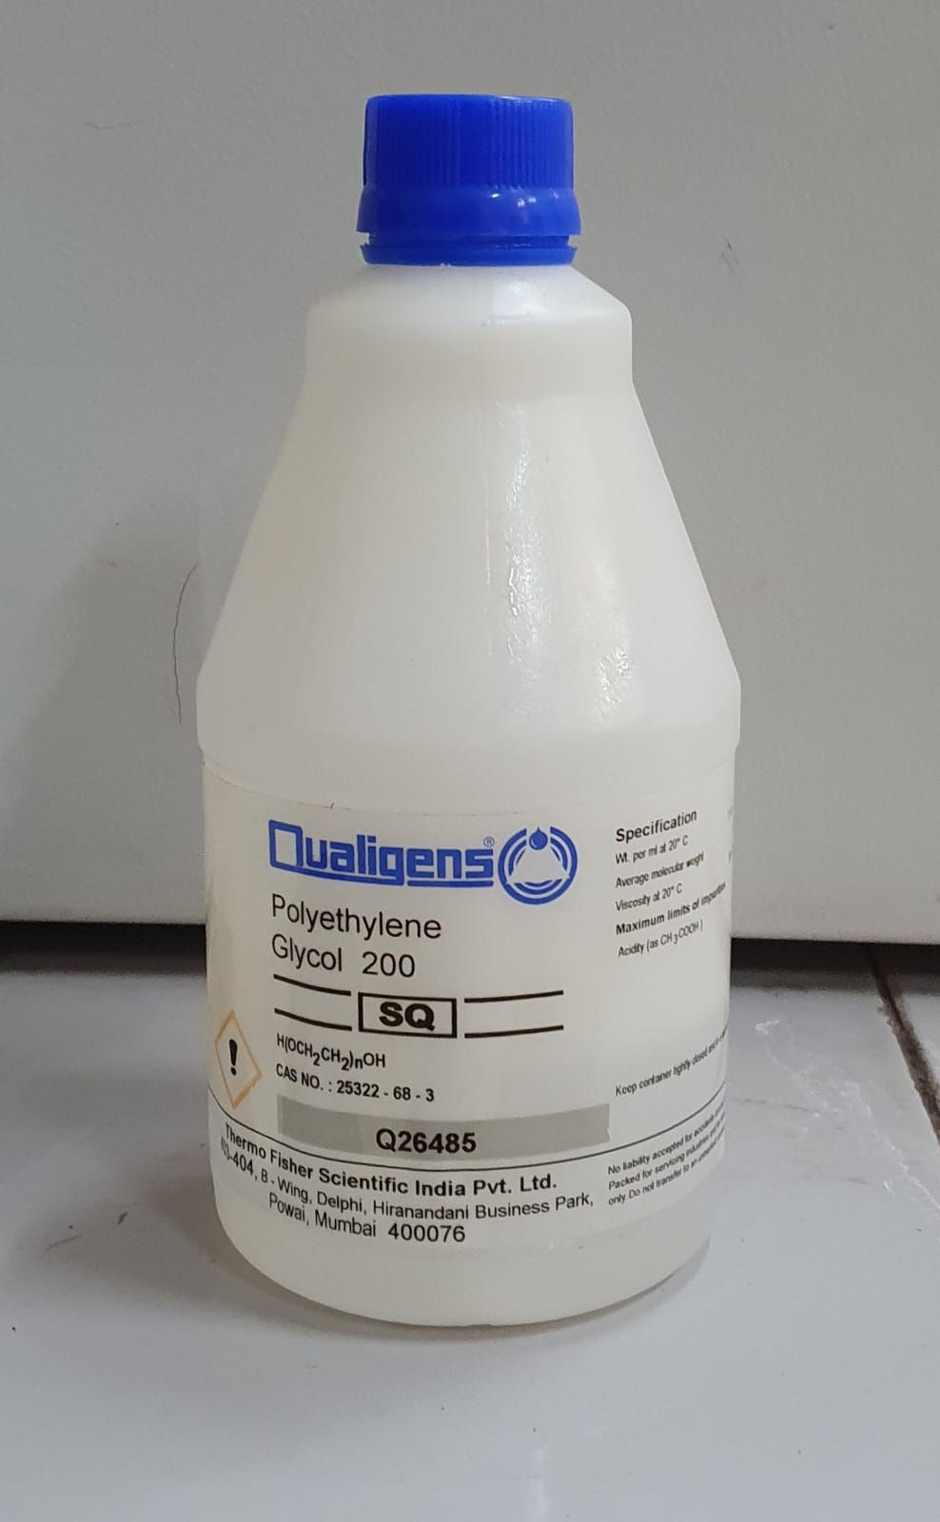
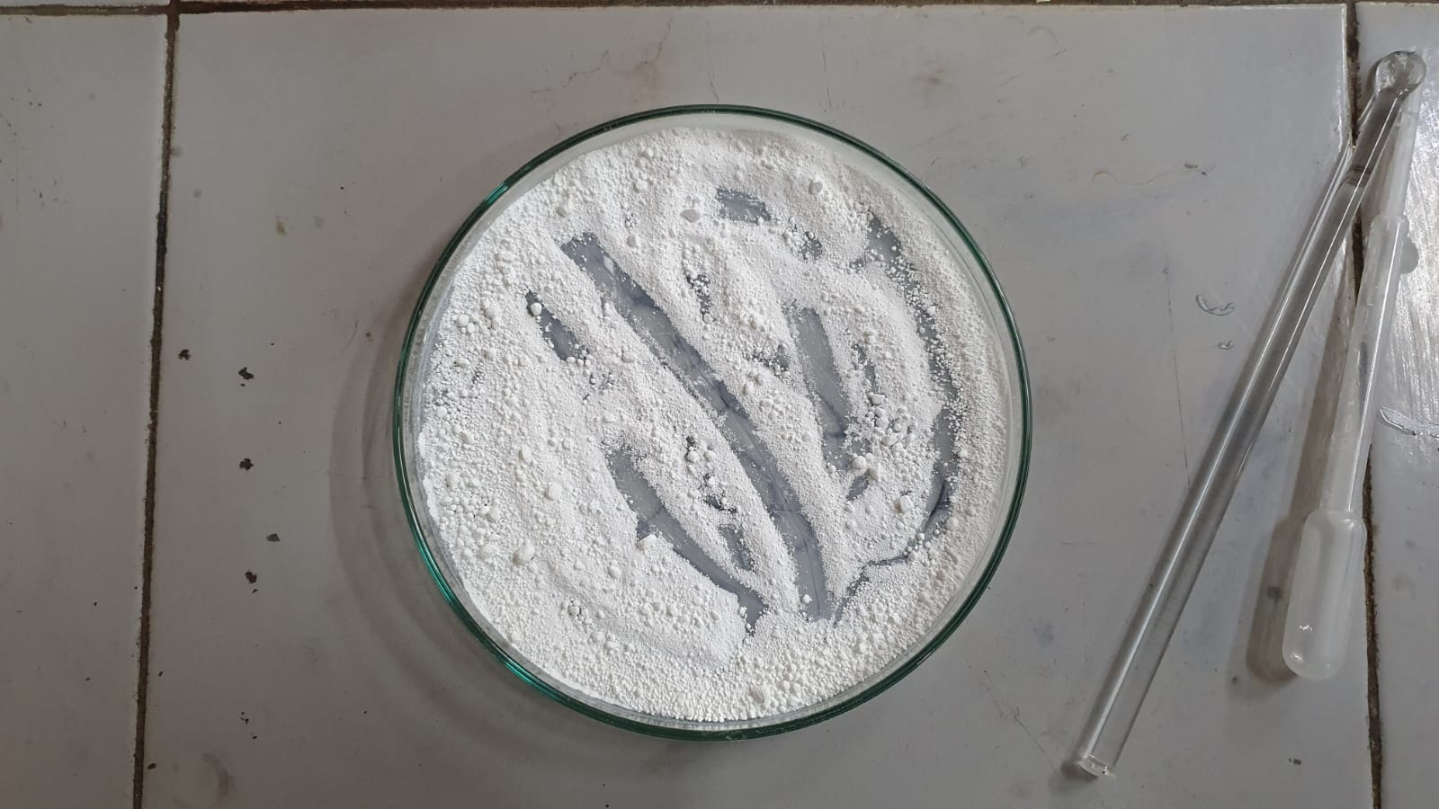
06.
Budget
We will require access to the following resources for the project:
Silica Particles of sizes : → 100 nm → 300 nm → 500 nm
Polyethylene glycol (PEG) of 200 mol. wt.
Ethanol
Equipments/Machines required:
→ Ultrasonicator → Rheometer → Oven → General lab equipments like gloves, beakers, stirrers etc
We will need approximately Rs. 25,000 and access to above mentioned resources present in the laboratories.

Slide 13
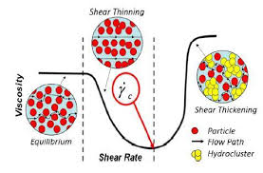
07.
Conclusion
In conclusion, in our project ,we shall:
Investigating the impact of particle size and temperature on shear thickening fluids (STFs).
Synthesizing STF samples using silica nanoparticles of varying sizes (100 nm, 300 nm, and 500 nm).
Conducting rheological studies to measure viscosity changes under different shear rates and temperatures (10°C, 20°C, and 30°C).
Developing an artificial neural network (ANN) model to predict STF viscosity.

Slide 14
References
F.J. Galindo-Rosales,F.J. Rubio-Hernández, and A. Sevilla, (2011) ‘An apparent viscosity function for shear thickening fluids’, Journal of Non-Newtonian Fluid Mechanics, 166(5–6), pp. 321–325. doi:10.1016/j.jnnfm.2011.01.001.
Mohammad Hemmat Esfe,Seyfolah Saedodin,Nima Sina,Masoud Afrand,Sara Rostami, (2015) ‘Designing an artificial neural network to predict thermal conductivity and dynamic viscosity of ferromagnetic nanofluid’, International Communications in Heat and Mass Transfer, 68, pp. 50–57. doi:10.1016/j.icheatmasstransfer.2015.06.013.
Marziyeh Ramzi , Mahdi Kashaninejad , Fakhreddin Salehi , Ali Reza Sadeghi Mahoonak, Seyed Mohammad Ali Razavi (2015) ‘Modeling of rheological behavior of honey using genetic algorithm–artificial neural network and adaptive neuro-fuzzy inference system’, Food Bioscience, 9, pp. 60–67. doi:10.1016/j.fbio.2014.12.001.
Zarei, M. and Aalaie, J. (2020) ‘Application of shear thickening fluids in material development’, Journal of Materials Research and Technology, 9(5), pp. 10411–10433. doi:10.1016/j.jmrt.2020.07.049.
Sanchi Arora, Animesh Laha, Abhijit Majumdar and Bhupendra Singh Butola (2017) ‘Prediction of rheology of shear thickening fluids using phenomenological and artificial neural network models’, Korea-Australia Rheology Journal, 29(3), pp. 185–193. doi:10.1007/s13367-017-0019-x.

Slide 15
THANK
YOU!

